Slide 1
Vacuum Evaporation Water Purification System
Phase One Presentation
ME423 Engineering Design VII
Section B
Thomas Battaglia, Kevin Birk, Nicolette Gurgone, Rushabh Naik, Robert Shea
Advisor: Dr. Connington

Slide 2
Overview
Vision and Mission
Concept Generation
Technical Background
Concept Selection
Stakeholders
Technical Analysis
Customer Needs
Budget
State of the Art Technology
Project Schedule

Slide 3
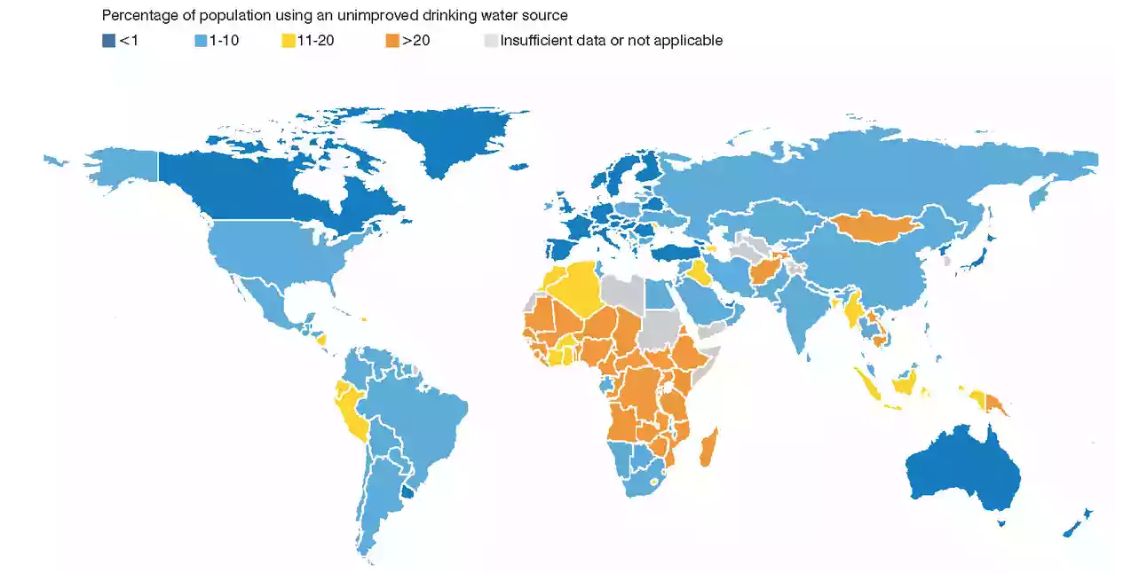
Vision and Mission
Vision: To fulfill the need of developing communities for clean drinking water.
A joint reported conducted by the World Health Organization and UNICEF in 2017 found that 2.1 billion people lack access to safe, readily available water at home
Approximately 250 million people living in sub-Saharan Africa collect drinking water from an unimproved water source
Mission: To design a human-powered, vacuum-driven distillation device that achieves complete water purification.

Slide 4
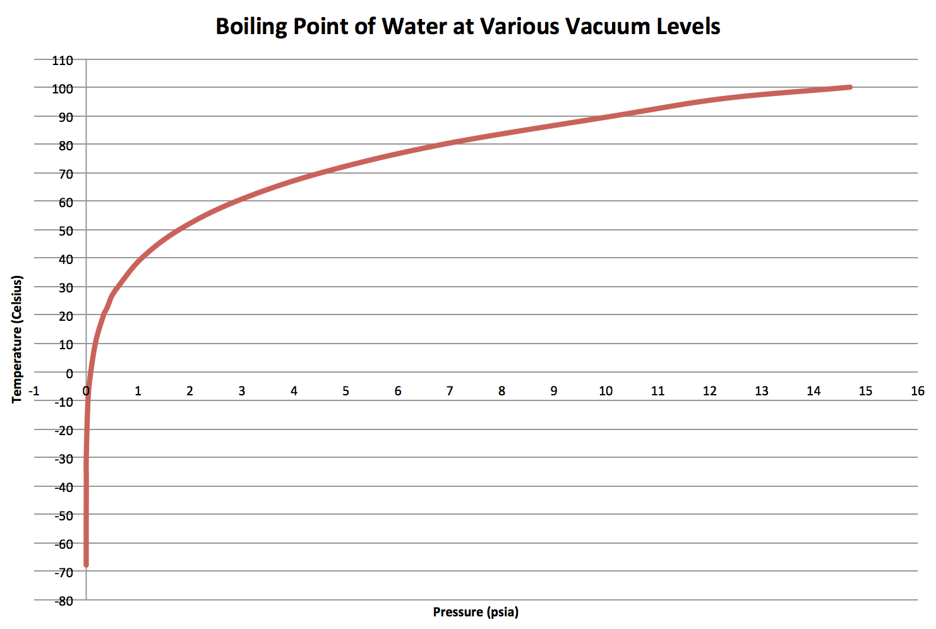
Technical Background
Vapor pressure: at a certain equilibrium temperature, the pressure exerted by a vapor on its condensed phase
By lowering the atmospheric pressure, the temperature at which water evaporates decreases

Slide 5
Stakeholders
Primary Stakeholders
Customers - Residents of Sub-Saharan Africa, Non-Profit Organizations
Investors - Mechanical Engineering Department at Stevens Institute of Technology, Venture Capital firms
Employees - Team members of this project, Dr. Connington, Outside Consultants
Passive Stakeholders
Competitors - Lifestraw, Cycloclean, Solarball
Governments/Organizations - Disaster Relief organizations, Underdeveloped countries, Humanitarian Organizations

Slide 6
Customer Needs
Primary Needs
Affordable
Sustainable energy source, no external power or battery needed.
Produce enough clean drinking water for one day for one person
Secondary Needs
User-friendly
Have a collection tank for the water
Easy to assemble
Easily maintained
Has a lifetime of at least 10 years

Slide 7
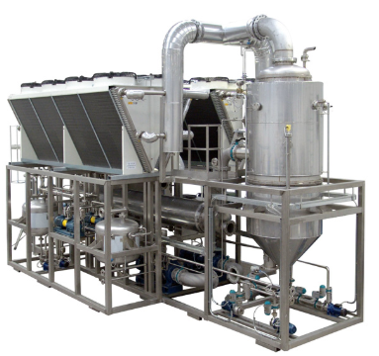
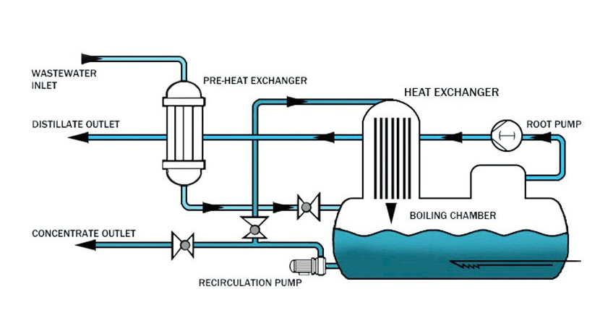
State of the Art Technology
Condorchem Envitech
Mechanical Vapor Compression Vacuum Evaporator

Slide 8
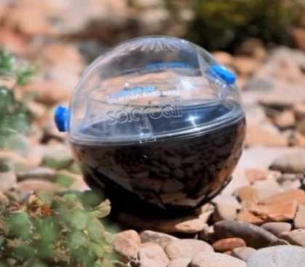
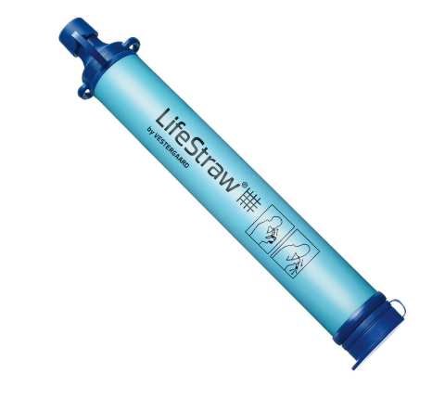
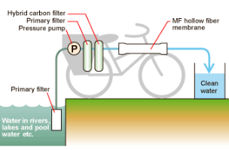
State of the Art Technology
Lifestraw
Solarball
Cycloclean
Notes:
Rob

Slide 9
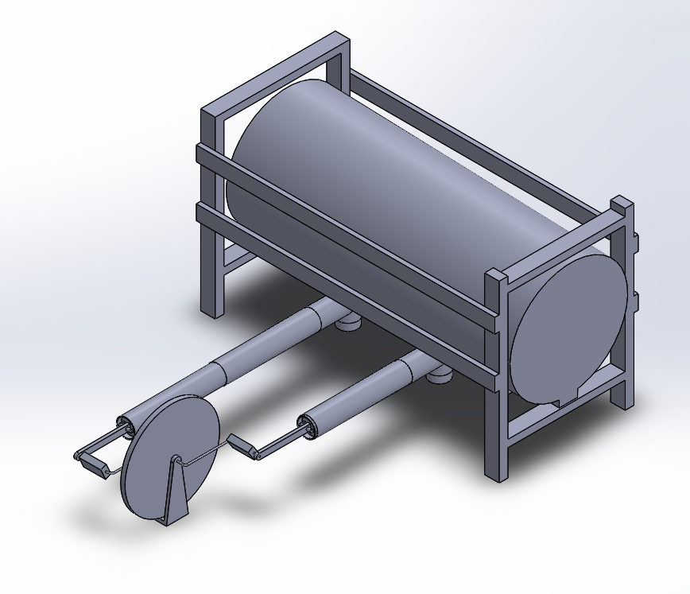
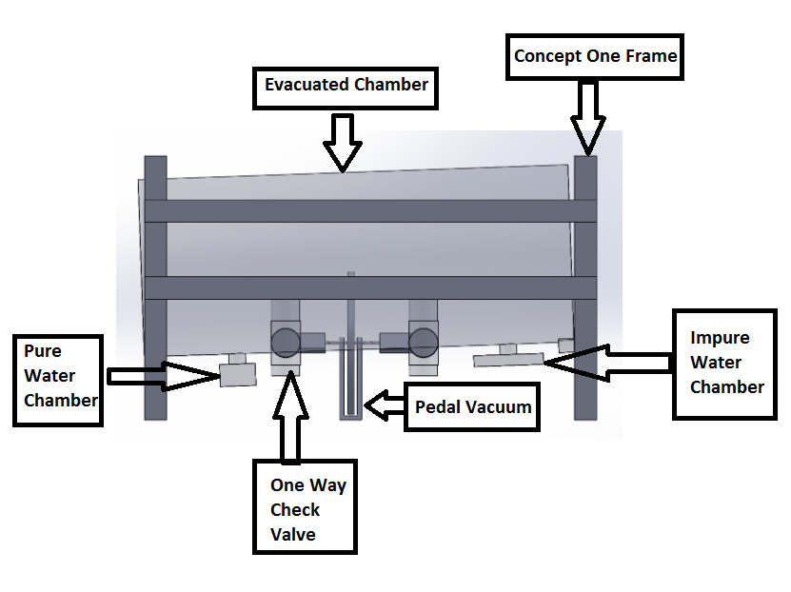
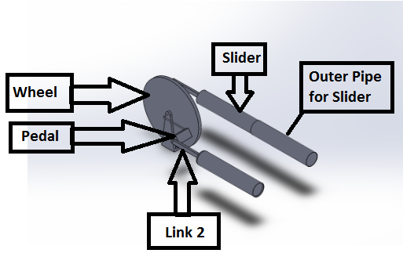
Concept Generation
Concept One: Cyclic Concept with Pedaling Pump Vacuum
Isometric View
Front View

Slide 10
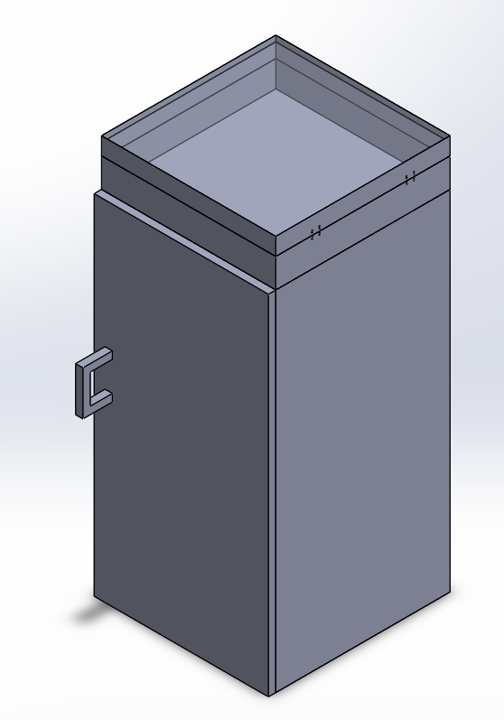
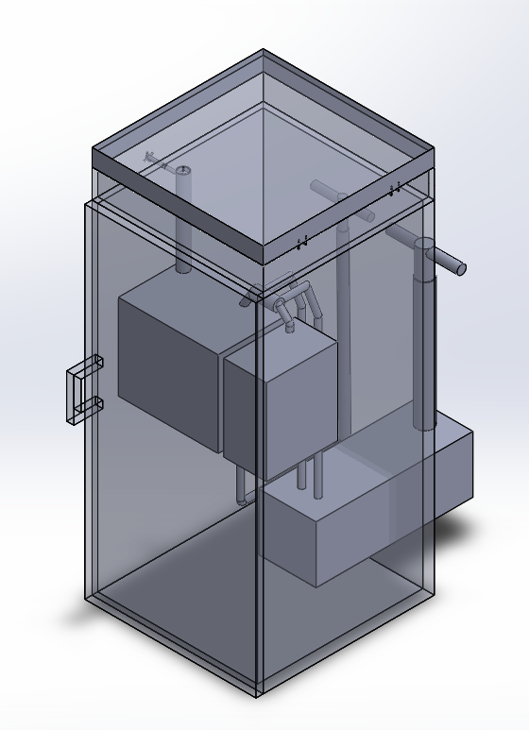
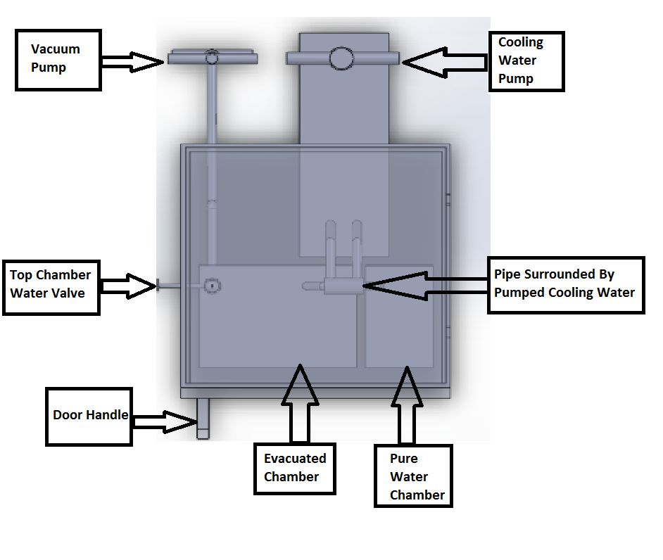
Concept Generation
Concept Two: Continuous-Evaporation Concept
Isometric View
Top View

Slide 11
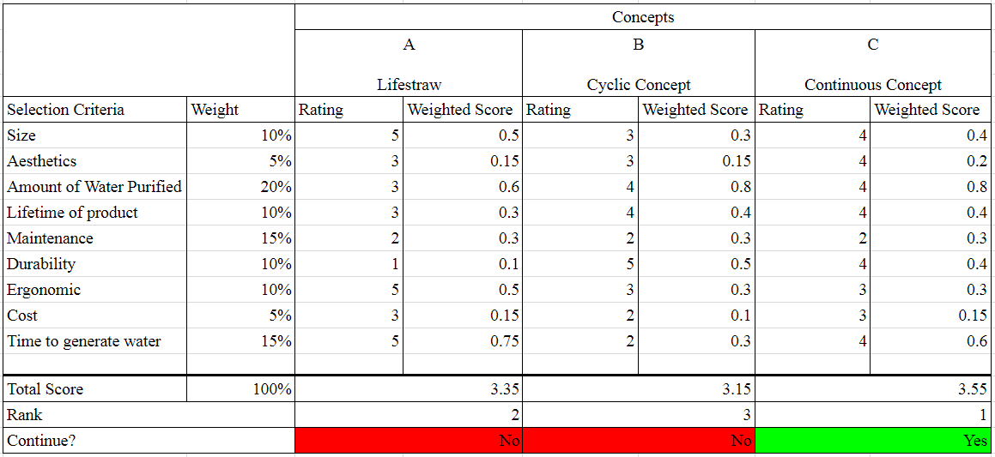
Concept Selection
Notes:
Rob

Slide 12
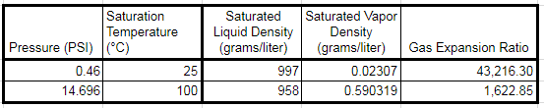



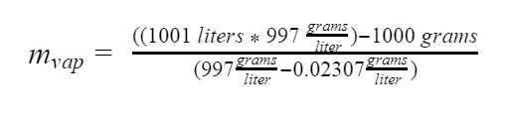
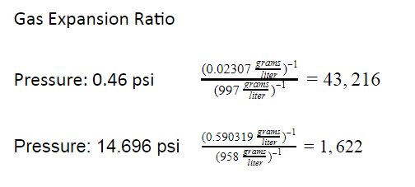

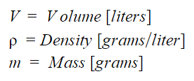
Technical Analysis
Water Properties and Water Collection
Water Properties Under Different Pressures
Mass of Water Vapor Collected in a Chamber

Slide 13


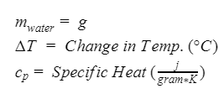


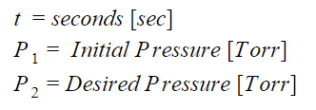

Technical Analysis
Basic Vacuum and Energy Calculations
Vacuum Speed
Energy to Raise the Temp. of 1 Liter of Water
Novice biker pedals 60 rpm or 1 revolution per second
Time to Evacuate Chamber
Total time: 220.75 seconds

Slide 14
Budget
Tentative Budget for Concept Two, the Continuous Concept, as of Phase One
Component | Function within Continuous Evaporation Conceptual Design | Quantity | Estimated Cost
Outer Shell Piping 2-1/2‘’ diameter | Shelters the Inner Piping and O-rings in the bike pedal assembly connected to one way check valves. | 8 ft | $5.47 per foot
Inner Shell Piping 2’ diameter | Goes in outer shell piping and o-rings placed on pipe. Creates suction in vacuum pump. | 4 ft | $3.25 per ft
O-Rings | Connects surface of inner pipe and outer pipe together. Creates air tight seal in vacuum | 1 line | $25 per line
Valves | Allows water from top chamber to enter the airlock | 1 | $75
Bike pedal assembly | Moves the inner pipe forward/back in outer pipe | 1 | $20
Steel Box X size | main body of system that holds inside components roughly 2ft X 2ft X 4.5 ft | 1 | $100
Panel of Glass | For the top chamber, sunlight comes through heating water | 4 square feet | $8 per square foot
 |  | Total Estimated Cost | $308.76

Slide 15
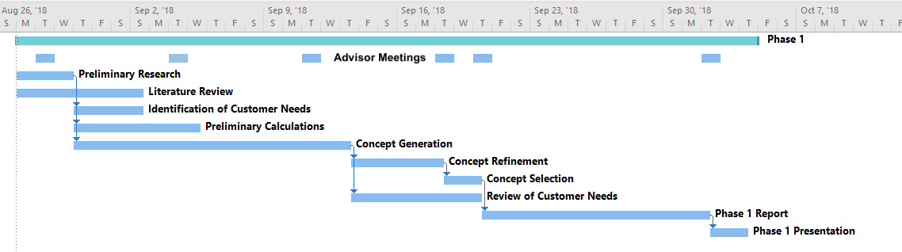
Project Schedule
Phase One Gantt Chart

Slide 16
Moving Forward
Future Milestones
Phase Two
Technical Analysis
Mass flow rates
Rates of evaporation and condensation
Heat transfer
Phase Three
Engineering Design
Environmental considerations
Design for manufacturability
Budget optimization

Slide 17
THANK YOU FOR LISTENING
QUESTIONS?

Slide 18
References
“2.1 Billion People Lack Safe Drinking Water at Home, More than Twice as Many Lack Safe Sanitation.” World Health Organization, World Health Organization, www.who.int/news-room/detail/12-07-2017-2-1-billion-people-lack-safe-drinking-water-at-home-more-than-twice-as-many-lack-safe-sanitation.
Cespedes, Andrea. “The Average Exercise Bike Pedaling Speed.” LIVESTRONG.COM, Leaf Group, 11 Sept. 2017, www.livestrong.com/article/396118-average-speed-human-pedaling-exercise-cycle/.
Chapter 3: Review of Basic Vacuum Calculations. Las Positas College , asiavacuumpumps.com/download/Article/1.pdf.
“Cycloclean.” Water Purification System, Nippon Basic Co., 2006, www.nipponbasic.ecnet.jp/e-cc.html
Hashem, Eman Ahmed. Nanotechnology in Water Treatment, Case Study: Egypt. Journal of Economics and Development Studies, Sept. 2014, jedsnet.com/journals/jeds/Vol_2_No_3_September_2014/18.pdf.
Home | JMP, washdata.org/.
“Household.” United Nations, United Nations, population.un.org/Household/index.html#/countries.
“JMP.” Home | JMP, washdata.org/data.
Paul, Rebecca. “6 Water-Purifying Devices for Clean Drinking Water in the Developing World.” Inhabitat Green Design Innovation Architecture Green Building, Inhabitat, 8 Nov. 2013,inhabitat.com/6-water-purifying-devices-for-clean-drinking-water-in-the-developing-world.
Progress on Drinking Water, Sanitation and Hygiene . World Health Organization, washdata.org/sites/default/files/documents/reports/2018-01/JMP-2017-report-final.pdf.
Slaymaker, Tom, and Robert Bain. “Access to Drinking Water around the World – in Five Infographics.” The Guardian, Guardian News and Media, 17 Mar. 2017, www.theguardian.com/global-development-professionals-network/2017/mar/17/access-to-drinking-water-world-six-infographics.
“United Nations Population Division | Department of Economic and Social Affairs.” United Nations, United Nations, www.un.org/en/development/desa/population/.
“What Does Brita Filter Out? Chlorine & More | Brita®.” Filtration Explained | Brita®, 9 Nov. 2017, www.brita.com/why-brita/what-we-filter/.
WHO/UNICEF Joint Monitoring Programme for Water Supply, Sanitation, and Hygiene. UNICEF, washdata.org/sites/default/files/documents/reports/2018-07/JMP-2017-annual-report.pdf.

